Slide 1
HOTEL AGGREGATOR Analysis
Lucy Adhiambo
Data scientist

Slide 2
Introduction
The project aims to analyze a dataset of hotel aggregator listings using Power BI.
The dataset comprises various attributes related to listings, hosts, reviews, and availability.
The objective is to create comprehensive visualizations and insights that shed light on trends, patterns, and factors influencing the performance of listings.
Through Power BI, we will explore key metrics such as pricing, availability, host characteristics, and review scores to derive actionable insights for improving the overall quality and competitiveness of the listings.

Slide 3
Dataset Description
id: Unique identifier for each listing.
listing_url: URL of the listing on the hotel aggregator platform.
scrape_id: Identifier for the data scraping event.
last_scraped: Date of the last data scrape.
source: Source of the listing information.
name: Name of the listing.
description: Description of the listing.
neighborhood_overview: Overview of the neighborhood where the listing is located.
picture_url: URL of the listing's picture.
host_id: Unique identifier for the host.
11. ... (and many more columns capturing details about hosts, location, property type, room details, amenities, pricing, availability, reviews, and other relevant information)

Slide 4
Project Objectives
1. Geographical Insights: Where are most popular neighborhoods and host concentrations?
2. Pricing and Availability Analysis: How do prices vary based on property type, room type and capacity? What are the peak availability periods?
3. Host Performance: Does super-host status, response times, and verification methods affect listing performance?
4. Review Scores and Guest Satisfaction: How do review scores impact listing performance. Can we identify areas for improvement?
5.Property Type and Room Analysis: What are the most popular property and room types. Are there any changing trends?

Slide 5
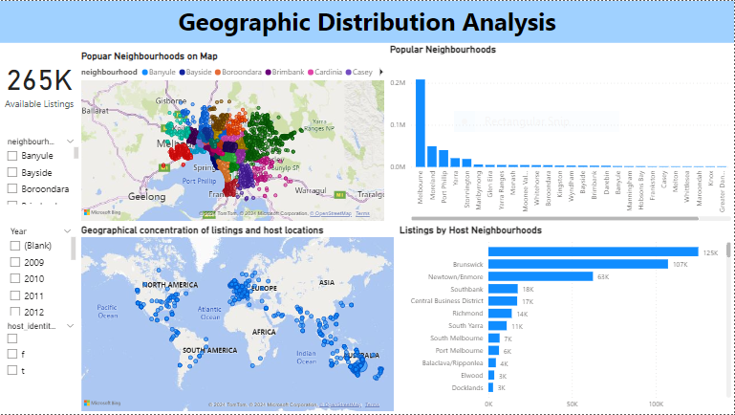

Slide 6
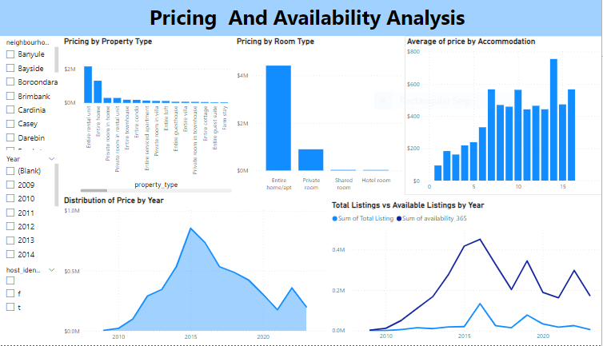

Slide 7
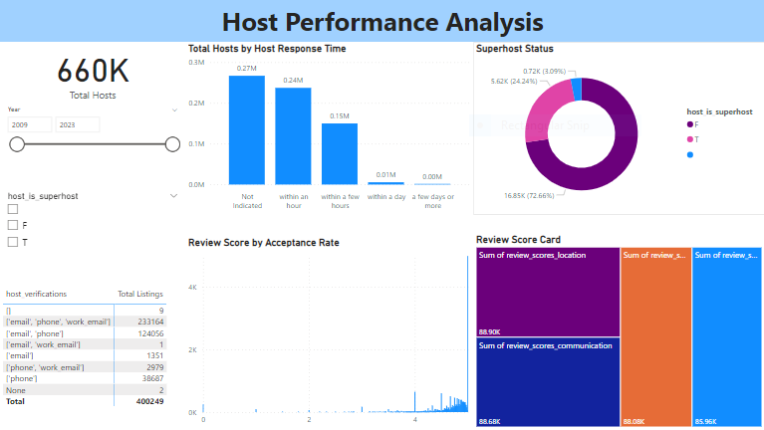

Slide 8
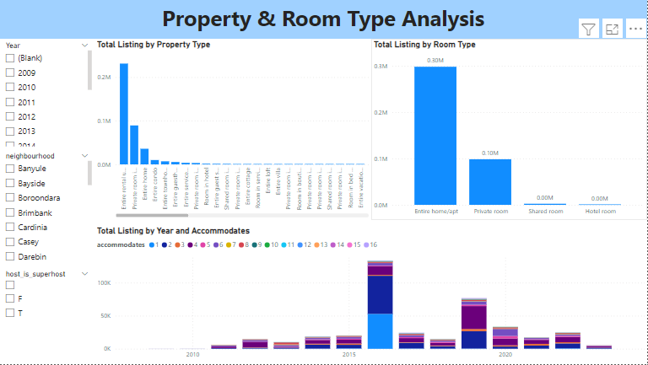

Slide 9
Findings
1. Geographical Insights: Melbourne Australia is the most popular neighborhood with 78% followed by Moreland at 18%. High concentrations of hosts are recorded in Brunswick Neighborhood.
2. Pricing and Availability Analysis: Highest prices are recorded for entire rental unit at $2,141, 271. Room type best sellers is entire home/apt at 4,417,801. The highest availability pattern was recorded in 2016
3. Host Performance: A total of 72.6% of votes are False on Super-host influence on Listings Performance. Response time and verification positively affected the results and performance with highs of 5 start rating.
4. Review Scores and Guest Satisfaction: The higher the response & acceptance rate, the higher the review score to up-to 5 star. Area for improvement is cleanliness since it had lower rating.
5. Property Type and Room Analysis: The most distributed property type is an Entire Rental Unit, 57.8% of listings. Followed by private room in homes that are 22.3% of the 14,000 listings. Identified popular room types are Entire home/apt followed by Private room. The most popular listings accommodate 2.

Slide 10
Recommendations
Targeted Listings : Based on popular neighborhoods and property/room type trends, hosts can optimize their listings to cater to specific guest preferences in high -demand areas .
Pricing Strategies : Pricing strategies should consider factors like property type, room capacity, and peak seasons .
Host Support : The source platform should offer resources or incentives to encourage faster response times, increased host verification methods all of which can positively impact listing performance .
Guest Feedback Integration : Integrate guest feedback from reviews into listing improvement suggestions for hosts . This can address areas like cleanliness or amenities .
Data Completeness . To ensure efficiency and integrity, the scraped site should ensure completeness in data .

Slide 11
Conclusion
This data analysis using Power BI provided valuable insights into factors influencing hotel aggregator listing performance.
By understanding geographical trends, pricing dynamics, host characteristics, and guest satisfaction factors, the platform can empower hosts to optimize their listings and attract more bookings.
Utilizing these insights, the platform can further enhance its overall listing quality and competitiveness in the market.

Slide 12
.
THANK YOU

